Slide 1
Programming in C and CPP
Mitali Hora
Department of Computer Applications

Slide 2
Structures
Structure is a user-defined datatype in C language which allows us to combine data of different types together.
Structure helps to construct a complex data type which is more meaningful.
It is somewhat similar to an Array, but an array holds data of similar type only. But structure on the other hand, can store data of any type, which is practical more useful.

Slide 3
Structures
For example: If I have to write a program to store Student information, which will have Student's name, age, branch, permanent address, father's name etc, which included string values, integer values etc, how can I use arrays for this problem, I will require something which can hold data of different types together.
In structure, data is stored in form of records.

Slide 4
Defining a structure
struct [structure_tag]
{
//member variable 1
//member variable 2
//member variable 3 ...
} [structure_variables];
struct defines a new data type which is a collection of primary and derived datatypes.
it's optional to provide your structure a name.
After the closing curly brace, we can specify one or more structure variables, again this is optional.

Slide 5
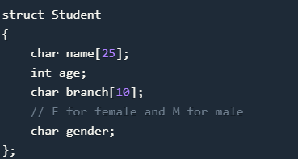
Example of Structure

Slide 6
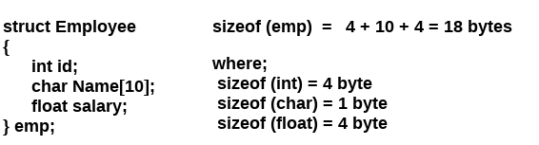

Slide 7
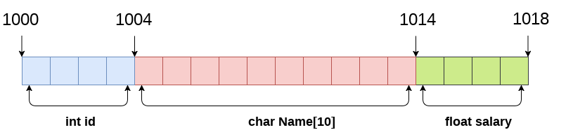
Memory Allocation

Slide 8
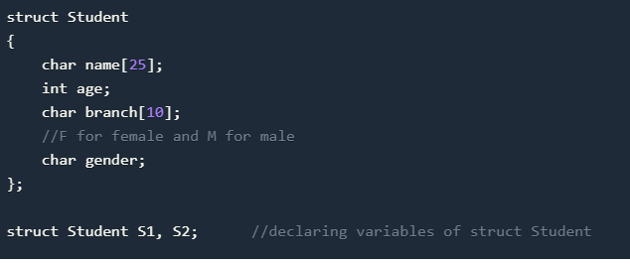
Declaring Structure Variables Declaring Structure variables separately

Slide 9
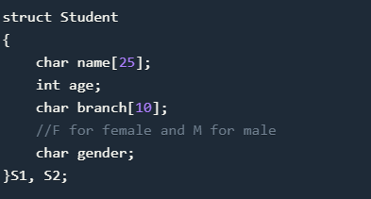
Declaring Structure Variables Declaring Structure variables with structure definition

Slide 10
Access structure members
struct myStructure { int myNum; char myLetter; }; int main() { // Create a structure variable of myStructure called s1 struct myStructure s1; // Assign values to members of s1 s1.myNum = 13; s1.myLetter = 'B'; // Print values printf("My number: %d\n", s1.myNum); printf("My letter: %c\n", s1.myLetter); return 0; }

Slide 11
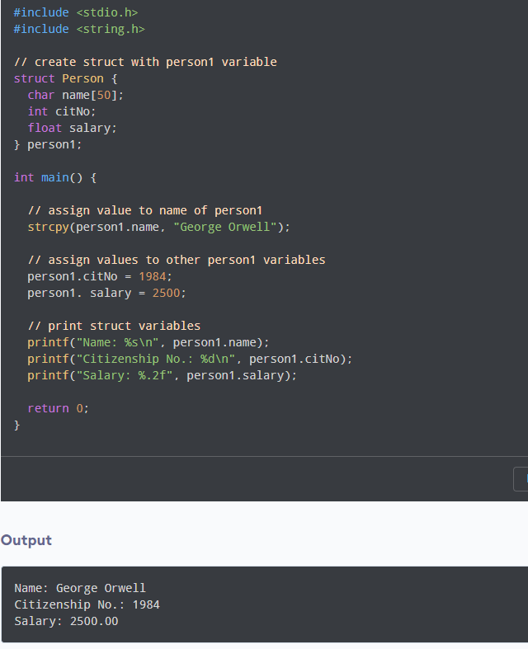
Accessing Structure Members

Slide 12
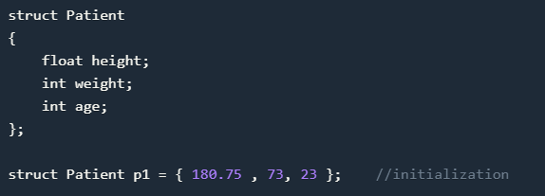
Structure Initialization Method 1

Slide 13
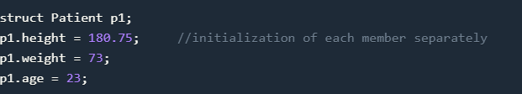
Structure Initialization Method 2

Slide 14
Array of Structure
We can also declare an array of structure variables. in which each element of the array will represent a structure variable.
Example : struct employee emp[5];
int emp[5];

Slide 15
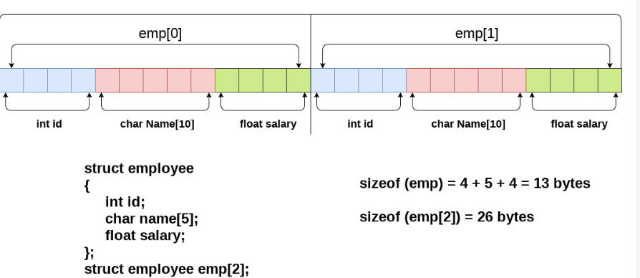
Array of Structure

Slide 16
Structure as Function Arguments
We can pass a structure as a function argument just like we pass any other variable or an array as a function argument.
Example :

Slide 17
Union
Union in c language is a user-defined data type that is used to store the different type of elements.
At once, only one member of the union can occupy the memory. In other words, we can say that the size of the union in any instance is equal to the size of its largest element.
It occupies less memory because it occupies the size of the largest member only.
Only the last entered data can be stored in the union. It overwrites the data previously stored in the union.
In structure each member has its own storage location, whereas all members of union uses a single shared memory location which is equal to the size of its largest data member.

Slide 18
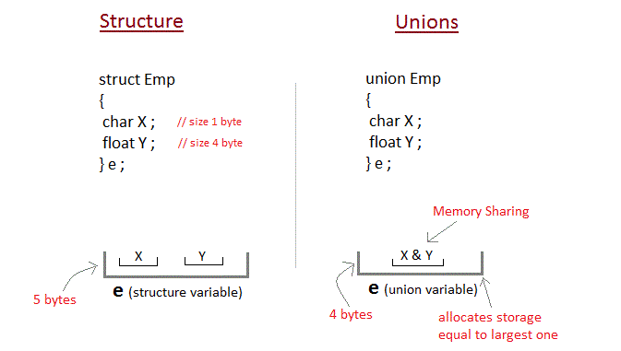
Union

Slide 19
This declares a variable It1 of type union item. This union contains three members each with a different data type.
However only one of them can be used at a time. This is due to the fact that only one location is allocated for all the union variables, irrespective of their size.
The compiler allocates the storage that is large enough to hold the largest variable type in the union.

Slide 20
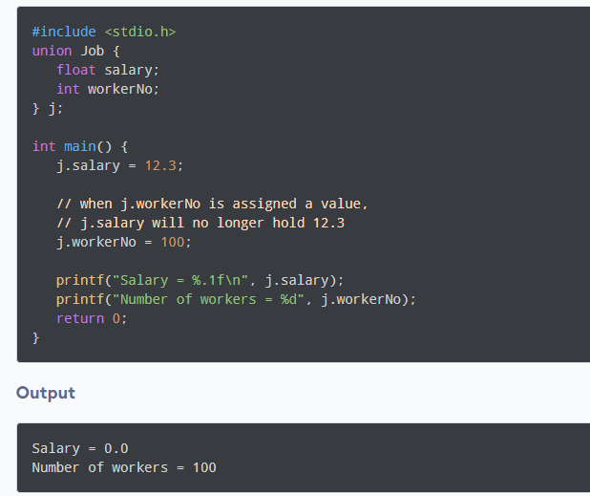
Example union

Slide 21
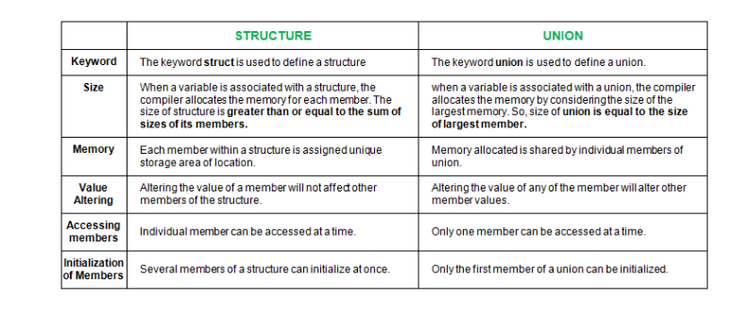
Difference between union and structure

Slide 22
typedef
The typedef is a keyword that is used to provide existing data types with a new name. The C typedef keyword is used to redefine the name of already existing data types.
When names of datatypes become difficult to use in programs, typedef is used with user-defined datatypes, which behave similarly to defining an alias for commands.
C typedef Syntax
typedef existing_name alias_name;

Slide 23
typedef unsigned char BYTE;
After this type definition, the identifier BYTE can be used as an abbreviation for the type unsigned char, for example..
BYTE b1, b2;
Use of typedef in C
Following are some common uses of the typedef in C programming:
The typedef keyword gives a meaningful name to the existing data type which helps other users to understand the program more easily.
It can be used with structures to increase code readability and we don’t have to type struct repeatedly.
The typedef keyword can also be used with pointers to declare multiple pointers in a single statement.
It can be used with arrays to declare any number of variables.

Slide 24
Example
#include <stdio.h>
// defining an alias using typedef
typedef long long ll;
// Driver code
int main()
{
// using typedef name to declare variable
ll var = 20;
printf("%ld", var);
return 0;
}
Output20

